Slide 1

CSE221: Algorithms
D & C Based Sorting Algorithms
Prepared by: A B M Muntasir Rahman [MUNR]

Slide 2
Divide & Conquer Approach
Divide
the problem (instance) into subproblems.
Conquer
the subproblems by solving them recursively.
Combine
the solutions to subproblems.

Slide 3
Examples
Binary/Ternary Search
Merge Sort
Quick Sort
Maximum Sum Subarray
Karatsuba’s Algorithm for Multiplication etc.
Time Complexity: aT(n/b) + f(n)

Slide 4
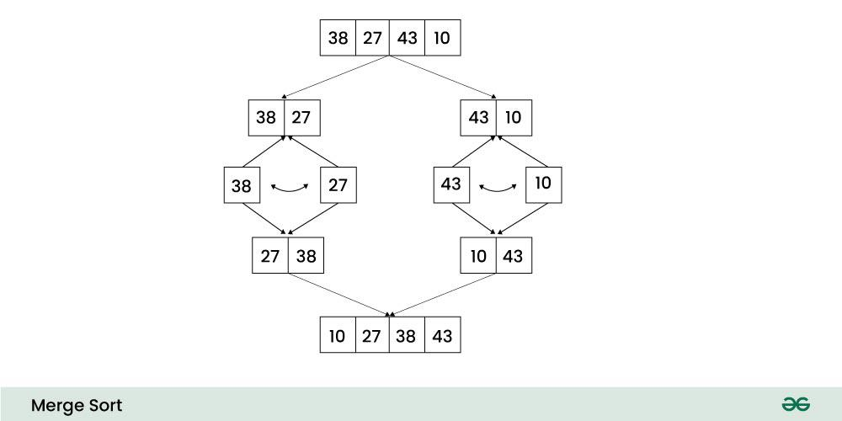
Merge Sort
A divide & conquer sorting algorithm
Recursively divides the array into smaller subarrays and then by sorting these subarrays while merging obtains the sorted array.

Slide 5
How does Merge Sort work?
Divide: Divide the array or dataset recursively into two halves until it can no more be divided.
Conquer: Each smallest subarray is automatically sorted individually using the merge sort algorithm.
Merge: The sorted subarrays are merged back together in sorted order and the process continues until all elements from both subarrays have been merged.

Slide 6
Merge Sort (Simulation)
9 | 4 | 5 | 2 | 1 | 7 | 4 | 6
9 | 4 | 5 | 2
1 | 7 | 4 | 6
9 | 4
5 | 2
1 | 7
4 | 6
9
4
5
2
1
7
4
6

Slide 7
Merge Sort (Simulation)
1 | 2 | 4 | 4 | 5 | 6 | 7 | 9
2 | 4 | 5 | 9
1 | 4 | 6 | 7
4 | 9
2 | 5
1 | 7
4 | 6
9
4
5
2
1
7
4
6

Slide 8
Merge Sort (Pseudocode)
mergeSort(arr)
if (len(arr) <= 1)
return arr
mid = len(arr) // 2
left = mergeSort(arr[:mid])
right = mergeSort(arr[mid:])
return merge(left, right)

Slide 9
Merge Sort (Pseudocode)
merge(left, right)
a = arrayOf(len(left) + len(right))
i, j, k = 0, 0, 0
while (i < len(left) && j < len(right))
if (left[i] <= right[j])
a[k] = left[i]
i = i + 1
else
a[k] = right[j]
j = j + 1
k = k + 1
while (i < len(left))
a[k] = left[i]
i = i + 1
k = k + 1
while (j < len(right))
a[k] = right[j]
j = j + 1
k = k + 1
return a

Slide 10
Time Complexity Analysis
mergeSort(arr) T(n)
if (len(arr) <= 1)
return arr
mid = len(arr) // 2 1
left = mergeSort(arr[:mid]) T(n/2)
right = mergeSort(arr[mid:]) T(n/2)
return merge(left, right) n

Slide 11
Time Complexity Analysis
∴ T(n) = 2T(n/2) + n
Solving with tree/substitution/master method,
T(n) = O(nlogn)

Slide 12
Merge Sort (Properties)
Time Complexity:
Best/Average/Worst Case: O(nlogn).
Space Complexity:
Best/Average/Worst case: O(n).
Stable: Yes.
Inplace: No.
Suitable for larger arrays. Unsuitable for smaller arrays and requires additional memory store the merged subarrays.

Slide 13
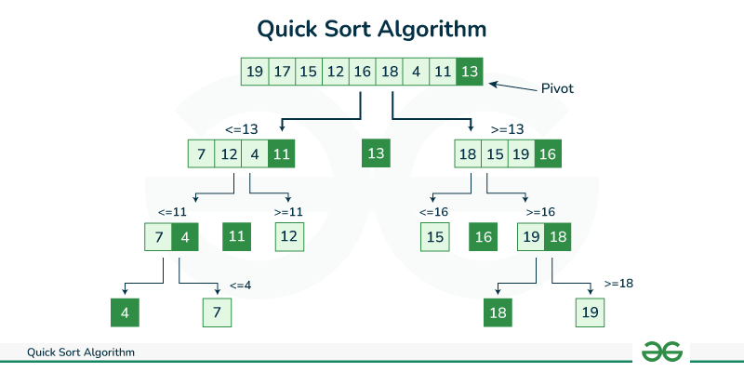
Quicksort
A divide and conquer sorting algorithm.
Picks a pivot and partitions the input array around the picked pivot by placing it in it’s correct position in sorted array.

Slide 14
How does Quicksort work?
Divide: The array or dataset is divide into subarrays by selecting a pivot element. While dividing, the pivot should be positioned in such a way that all elements less than pivot are on the left side and elements greater than the pivot are on the right side of the pivot. This process continues until each subarray contains a single element.
Conquer: Each smallest subarray is automatically sorted at this point.
Combine: All subarrays are combined to form a sorted array.

Slide 15
Quicksort (Simulation)
Pivot
7 | 2 | 1 | 6 | 8 | 5 | 3 | 4
partition
<= 4
> 4
Pivot
2 | 1 | 3 | 4 | 7 | 6 | 8 | 5
Pivot
Pivot
2 | 1 | 3
7 | 6 | 8 | 5
partition
partition
Pivot
Pivot
7 | 6 | 8
2 | 1
5
3
Pivot
7 | 6
2
8

Slide 16
Quicksort (Pseudocode)
partition(arr, start, end){
pivot = arr[end]
pIndex = start
for(int i = start, i <= end-1; i++){
if (arr[i] <= pivot){
swap(arr[i], arr[pIndex])
pIndex = pIndex + 1
}
}
swap(arr[pIndex], arr[end])
return pIndex
}
quickSort(arr, start, end){
if (start >= end){
return arr
}
pIndex = partition(arr, start, end)
quickSort(arr, start, pIndex - 1)
quickSort(arr, pIndex + 1, end)
return arr
}

Slide 17
Time Complexity Analysis
quickSort(arr, start, end){
if (start >= end){
return arr
}
pIndex = partition(arr, start, end)
quickSort(arr, start, pIndex - 1)
quickSort(arr, pIndex + 1, end)
return arr
}
T(n)
n
T(n/2)
T(n/2)

Slide 18
Time Complexity Analysis
∴ T(n) = 2T(n/2) + n
Solving with tree/substitution/master method,
T(n) = O(nlogn)

Slide 19
Worst Case
1 | 2 | 3 | 4 | 5 | 6 | 7 | 8
For above sorted array, if we choose first element as pivot, there will be no left subarray. Again, if we choose last element as pivot, there will be no right subarray.
In such cases, the recurrence relation becomes T(n) = T(n - 1) + n. Which, by solving, we get O(n²) in worst case.
However, this can be easily avoided by choosing mid or other element as pivot.

Slide 20
Quick Sort (Properties)
Time Complexity:
Best/Average Case: O(nlogn).
Worst Case: O(n²).
Space Complexity:
Best/Average Case: O(log n).
Worst Case: O(n).
Stable: No.
Inplace: Yes (in best/average case).
Suitable for larger arrays. Unsuitable for smaller arrays and is not a stable sorting algorithm.

